Slide 1
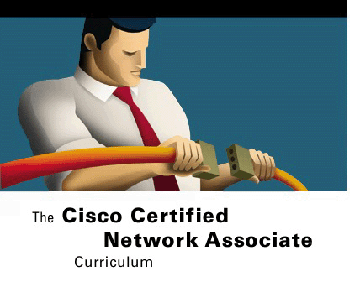



VIRTUAL LANs
Switching Basics and Intermediate Routing
Version 3.0
Cisco Regional Networking Academy

Slide 2
Objectives
Explain the concept of VLANs.
Configure static VLANs on 29xx series Catalyst switchs.

Slide 3
Table of Content
1 | VLAN concepts
2 | VLAN configuration
3 | Troubleshooting VLANs

Slide 4

VLAN CONCEPTS

Slide 5
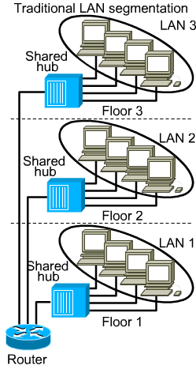
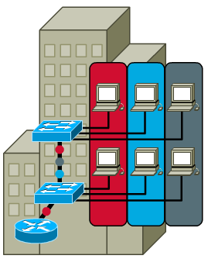
VLAN introduction
Notes:
See 8.1.1
VLANs logically segment switched networks based on the functions, project teams, or applications of the organization regardless of the physical location or connections to the network. All workstations and servers used by a particular workgroup share the same VLAN, regardless of the physical connection or location.
Configuration or reconfiguration of VLANs is done through software. Physically connecting or moving cables and equipment is unnecessary when configuring VLANs

Slide 6
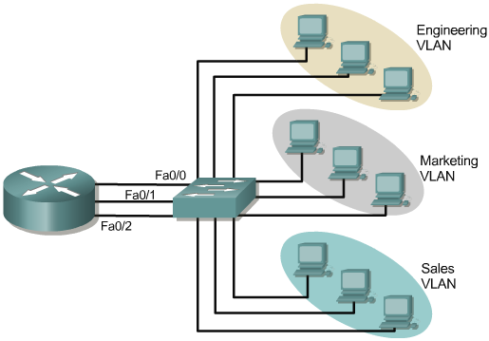
Broadcast domains with VLANs and routers
Notes:
See 8.1.2
three separate broadcast domains are created. The router routes traffic between the VLANs using Layer 3 routing.
Implementing VLANs on a switch causes the following to occur:
The switch maintains a separate bridging table for each VLAN.
If the frame comes in on a port in VLAN 1, the switch searches the bridging table for VLAN 1.
When the frame is received, the switch adds the source address to the bridging table if it is currently unknown.
The destination is checked so a forwarding decision can be made.
For learning and forwarding the search is made against the address table for that VLAN only.

Slide 7
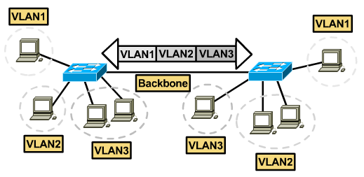
Frames Tagging
ISL
802.1Q
Notes:
See 8.1.5

Slide 8
VLAN types
Port-based VLANs
MAC address based VLANs
Protocol based VLANs

Slide 9
Port-based VLANs
Most common configuration method.
Ports assigned individually.
Often implement when DHCP is used.

Slide 10
MAC address base VLANs
Rarely implemented today.
Each address must be entered into the switch and configured individually.
Difficult to administer, troubleshoot and manage.

Slide 11
Protocol base VLANs
Configured like MAC addresses, but instead uses a protocol or IP address.
No longer comon because of DHCP.

Slide 12
Benefits of VLANs
Easily move workstations on the LAN.
Easily add workstations to the LAN.
Easily change the LAN configuration.
Easily control network traffic.
Improve security.

Slide 13

VLAN CONFIGURATION

Slide 14
End-to-end VLANs and Geographic VLANs
End-to-end VLANs:
  devices to be grouped based upon resource usage.
  Allow 80/20 rule.
Geographic VLANs:
  Devices to be grouped based on geographic.
  Allow 20/80 rule.
Notes:
See 8.2.2
As many corporate networks have moved to centralize their resources, end-to-end VLANs have become more difficult to maintain. Users are required to use many different resources, many of which are no longer in their VLAN. Because of this shift in placement and usage of resources, VLANs are now more frequently being created around geographic boundaries rather than commonality boundaries.

Slide 15
Configuring static VLANs
Create VLANs:
  Switch# vlan database
  Switch(vlan)# vlan_number
  Switch(vlan)# exit
Assign ports to VLANs:
  Switch(config)# interface fastethernet 0/9
  Switch(config-if)#switchport access vlan vlan_number
Deleting VLANs
  Use the no form of the command.
Notes:
See 8.2.3, 8.2.6

Slide 16
Verifying and save VLAN configuration
show vlan
show vlan brief
show vlan id id_number
copy running-config tftp
Notes:
See 8.2.4

Slide 17

TROUBLESHOOTING VLAN

Slide 18
VLAN troubleshooting process
LEDs
(or network management equivalent) O.K ?
Switch configuration OK?
Physical link connection OK?
Fix any problem with switch hardware
Fix any problem with configuration statements
Check with CDP, fix any cabling problems
Vlan configuration OK?
L2 path between switchs OK?
Fix any VLAN, spanning tree or intermediate router problems
Fix any switch trunking or ISL configuration problems
Notes:
See 8.3.1, 8.3.2

Slide 19
Preventing broadcast storms
Setting threshold values to high or low discards excessive broadcast, multicast, or unicast MAC traffic.
Minimize the STP processes occurring between devices.
Notes:
See 8.3.3
it becomes necessary to reduce BPDU traffic, put the timers on the root bridge at their maximum values. Specifically, set the forward delay parameter to the maximum of 30 seconds, and set the max_age parameter to the maximum of 40 seconds

Slide 20
Troubleshooting VLANs
Show vlan
Show spanning-tree
Show sw-vlan
Debug sw-vlan packet
Notes:
See 8.3.4

Slide 21
Scenario 1: A trunk link cannot be established between a switch and a router
Make sure that the port is connected and not receiving any physical-layer, alignment or frame-check-sequence (FCS) errors.
Verify that the duplex and speed are set properly between the switch and the router.
Configure the physical router interface with one subinterface for each VLAN that will route traffic.
Confirm that the router is running an IOS release that supports trunking.
Notes:
See 8.3.5

Slide 22
Scenario 2: VTP is not correctly propagating VLAN configuration changes
Make sure the switches are connected through trunk links.
Make sure the VTP domain name is the same on all switches that need to communicate with each other.
Check the VTP mode of the switch.
If using VTP passwords, the same password must be configured on all switches in the VTP domain.
Notes:
See 8.3.5

Slide 23
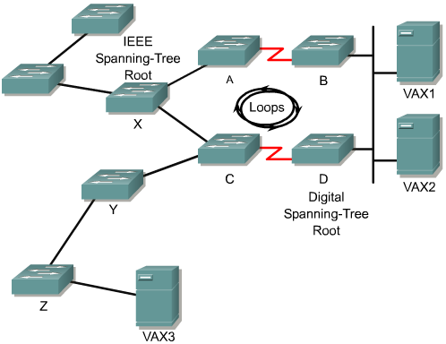
Scenario 3: Dropped packets and loops
Notes:
See 8.3.5
Problems can arise for internetworks in which both IEEE and DEC spanning-tree algorithms are used by bridging nodes. These problems are caused by differences in the way the bridging nodes handle spanning tree BPDU packets, or hello packets, and in the way they handle data.
In this scenario, Switch A, Switch B, and Switch C are running the IEEE spanning-tree algorithm. Switch D is inadvertently configured to use the DEC spanning-tree algorithm.
Switch A claims to be the IEEE root and Switch D claims to be the DEC root. Switch B and Switch C propagate root information on all interfaces for IEEE spanning tree. However, Switch D drops IEEE spanning-tree information. Similarly, the other routers ignore Router D's claim to be root.
The result is that in none of the bridges believing there is a loop and when a broadcast packet is sent on the network, a broadcast storm results over the entire internetwork. This broadcast storm will include Switches X and Y, and beyond.
To resolve this problem, reconfigure Switch D for IEEE. Although a configuration change is necessary, it might not be sufficient to reestablish connectivity.

Slide 24

Summary
Definition of VLANs
Configuring static VLANs on 29xx series Catalyst switches
The steps for general troubleshooting in switched networks

Slide 25

Q&A
Notes:
_________________________________________________________________________
_________________________________________________________________________
_________________________________________________________________________
_________________________________________________________________________
_________________________________________________________________________
_________________________________________________________________________
_________________________________________________________________________
_________________________________________________________________________
_________________________________________________________________________
_________________________________________________________________________
_________________________________________________________________________
_________________________________________________________________________
_________________________________________________________________________
_________________________________________________________________________
_________________________________________________________________________
_________________________________________________________________________
_________________________________________________________________________
_________________________________________________________________________
_________________________________________________________________________

Slide 26
Enjoy the Course
Notes:
_________________________________________________________________________
_________________________________________________________________________
_________________________________________________________________________
_________________________________________________________________________
_________________________________________________________________________
_________________________________________________________________________
_________________________________________________________________________
_________________________________________________________________________
_________________________________________________________________________
_________________________________________________________________________
_________________________________________________________________________
_________________________________________________________________________
_________________________________________________________________________
_________________________________________________________________________
_________________________________________________________________________
_________________________________________________________________________
_________________________________________________________________________
_________________________________________________________________________
_________________________________________________________________________

